Slide 1


OUR HEALTH.
OUR VOICES.
OUR CHOICES.
Black maternal reproductive justice, healthcare equity & menopause
April V. Ashe | Executive Director, Pennsylvania Legislative Black Caucus
Community conversation convened by Red, Wine & Blue • NCNW • League of Women Voters of PA
Notes:
Opening (1 minute). Thank conveners and PLBC Chair Rep. Napoleon Nelson. Reproductive justice extends across the lifespan.

Slide 2
PA LEGISLATIVE BLACK CAUCUS
Reproductive justice is lifelong
It is more than a single healthcare decision.
Before pregnancy
During & after birth
Across midlife
Access to preventive care, reproductive information, affordable services and the freedom to make informed decisions.
Safe prenatal care, supportive delivery, postpartum monitoring, mental healthcare and family resources.
Perimenopause and menopause education, appropriate treatment, workplace support and healthy aging.
PA MOMNIBUS 2.0 • BLACK MATERNAL HEALTH • OCTOBER 2026
02
Notes:
Explain the reproductive justice framework: the ability to have children, not have children, and parent in safe and sustainable communities. Bridge to women who are caregivers and workers.

Slide 3
PA LEGISLATIVE BLACK CAUCUS
The disparity behind the discussion
Historical Pennsylvania pregnancy-associated mortality figures
148
81
Black Pennsylvanians
White Pennsylvanians
Deaths per 100,000 live births • Historical figures cited by the PA Black Maternal Health Caucus in 2024
PA MOMNIBUS 2.0 • BLACK MATERNAL HEALTH • OCTOBER 2026
03
Notes:
1.5 minutes. These are historical pregnancy-associated mortality figures, not current 2026 rates. Pregnancy-associated deaths include deaths during pregnancy or within one year regardless of cause. Focus on access, economic conditions and patient experience.

Slide 4
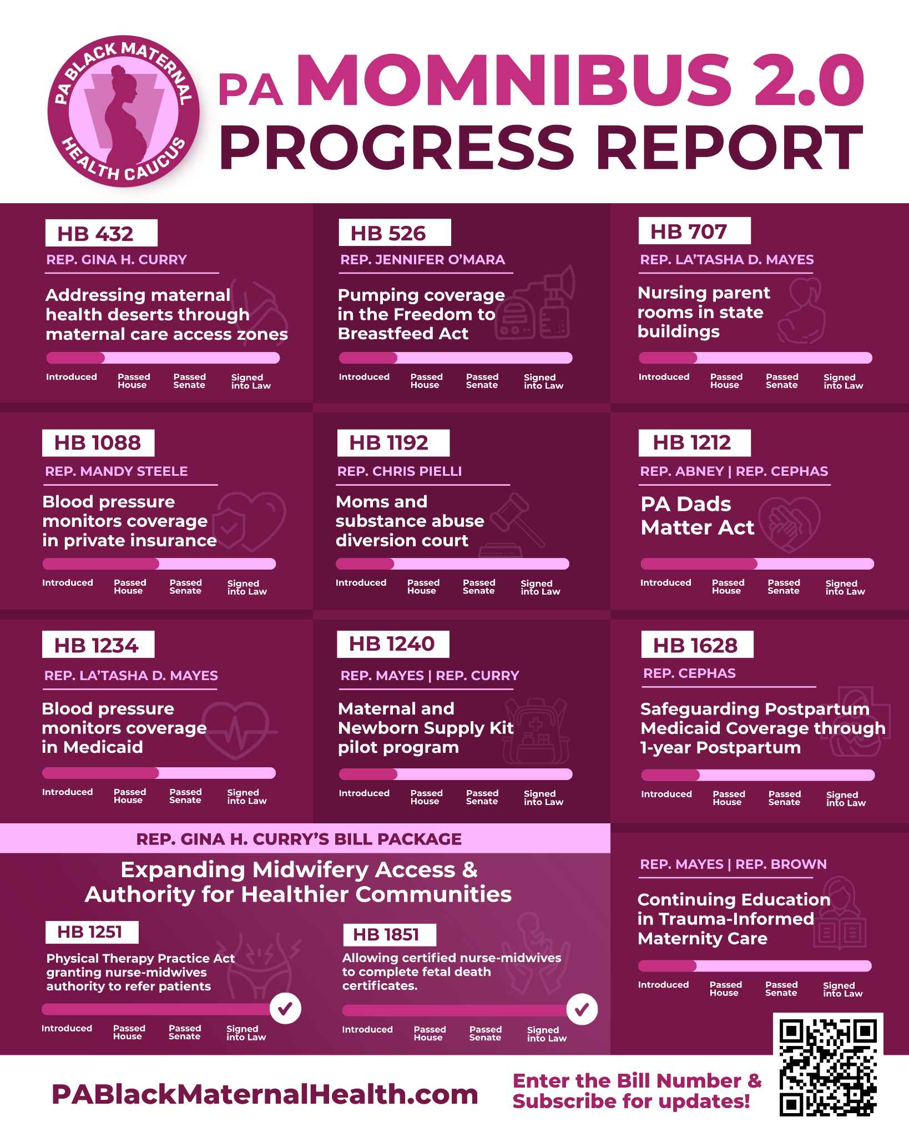
PA LEGISLATIVE BLACK CAUCUS
PA MOMNIBUS 2.0: policy in motion
A coordinated set of proposals addressing:
Maternal care deserts and access zones
Blood pressure monitoring and coverage
Breastfeeding and nursing-parent support
Postpartum Medicaid protections
Midwifery, family support and education
PA MOMNIBUS 2.0 • BLACK MATERNAL HEALTH • OCTOBER 2026
04
Notes:
Introduce the supplied PA MOMNIBUS 2.0 Progress Report. Clarify that progress bars show different stages: introduced, passed House, passed Senate, signed into law. The full graphic is included again at the end for reference.

Slide 5
PA LEGISLATIVE BLACK CAUCUS
Addressing maternal care deserts
HB 432 • Rep. Gina H. Curry
The lived experience
Maternal care access zones would help identify areas where pregnant women face limited access to obstetric services.
Long travel times, unreliable transportation and limited local providers can turn routine prenatal visits into major challenges.
Policy question: How do we get quality maternal care closer to the communities that need it?
PA MOMNIBUS 2.0 • BLACK MATERNAL HEALTH • OCTOBER 2026
05
Notes:
Approximately 1 minute. Explain that a maternal care desert is an area with inadequate obstetric services. Avoid suggesting HB 432 is enacted.

Slide 6
PA LEGISLATIVE BLACK CAUCUS
Care, coverage and support after delivery
HB 1088 + HB 1234
HB 526 + HB 707
HB 1628
Blood pressure monitor coverage through private insurance and Medicaid, respectively.
Breast milk pumping protections and nursing-parent rooms in state buildings.
Safeguarding postpartum Medicaid coverage through one year after childbirth.
Pregnancy-related complications and care needs can continue long after childbirth.
PA MOMNIBUS 2.0 • BLACK MATERNAL HEALTH • OCTOBER 2026
06
Notes:
1.5 minutes. Discuss hypertension and preeclampsia, pumping at work, and the need for continuous postpartum coverage. The slide describes legislative proposals; do not call them enacted.

Slide 7
PA LEGISLATIVE BLACK CAUCUS
Midwifery and family-centered care
HB 1251 + HB 1851
HB 1212 + HB 1240
The MOMNIBUS graphic identifies both bills as signed into law, expanding aspects of professional practice and midwifery authority.
The PA Dads Matter Act and a maternal/newborn supply-kit pilot address family engagement and practical supports.
Legislative progress matters — and implementation, provider participation and outcomes matter too.
PA MOMNIBUS 2.0 • BLACK MATERNAL HEALTH • OCTOBER 2026
07
Notes:
1 minute. The graphic marks HB 1251 and HB 1851 as enacted. Emphasize distinction between bills and laws and need to measure real-world impact.

Slide 8
PA LEGISLATIVE BLACK CAUCUS
Reproductive freedom meets affordability
A right on paper does not always mean access in practice.
INSURANCE
TRANSPORTATION
Can a woman afford recommended care?
Can she reach an available provider?
TIME & WORK
CHILDCARE
Can she take leave without losing wages?
Who cares for her family during appointments?
PA MOMNIBUS 2.0 • BLACK MATERNAL HEALTH • OCTOBER 2026
08
Notes:
1 minute. Connect healthcare with wages, housing, childcare and transportation. Acknowledge that reproductive liberty and affordability have distinct policy dimensions and viewpoints.

Slide 9
PA LEGISLATIVE BLACK CAUCUS
Menopause belongs in the healthcare conversation
Care does not end when childbearing years end.
HB 1345 • Rep. Morgan Cephas
Education + workplace support
Proposes Medical Assistance coverage for qualifying menopause treatments. The House passed the bill October 7, 2026.
HB 1411 addresses menopause education. HB 2135 addresses workplace accommodations related to menopause and pregnancy.
Symptoms may affect sleep, concentration, work and daily life — women deserve informed, individualized care.
PA MOMNIBUS 2.0 • BLACK MATERNAL HEALTH • OCTOBER 2026
09
Notes:
1.5–2 minutes. Discuss perimenopause, hot flashes, sleep disruption, mental wellbeing and respectful clinical assessment. House passage is not enactment. Avoid claiming any particular therapy is right for everyone.

Slide 10
PA LEGISLATIVE BLACK CAUCUS
Where do we go from here?
1. How do we make maternal and menopause care accessible and affordable?
2. How will we measure whether enacted programs reach Black women?
3. What do women need from employers, healthcare systems and legislators?
Community experience is essential evidence for policy discussions.
PA MOMNIBUS 2.0 • BLACK MATERNAL HEALTH • OCTOBER 2026
10
Notes:
1 minute. Invite the audience to share experiences and ask questions. Keep the civic invitation nonpartisan and issue-focused.

Slide 11
EVERY WOMAN.
EVERY STAGE.
EVERY VOICE.
Our health. Our voices. Our choices. Our future.
April V. Ashe • Executive Director, Pennsylvania Legislative Black Caucus
Notes:
Close (1 minute). Every woman deserves informed choices and responsive care at every life stage. Thank the conveners and audience.

Slide 12
SOURCE GRAPHIC
Reference: PA MOMNIBUS 2.0 progress report
PA MOMNIBUS 2.0 • BLACK MATERNAL HEALTH • OCTOBER 2026
12
Notes:
This is the source graphic supplied for the presentation. Bill numbers can be searched at https://www.palegis.us/legislation/bills . Note that the graphic reflects a snapshot and statuses can change.

Slide 13
PRESENTER REFERENCE
Legislation & source links
Pennsylvania General Assembly
https://www.palegis.us/legislation/bills
PA Black Maternal Health Caucus
https://pablackmaternalhealth.com/
HB 1345 — menopause coverage
https://www.palegis.us/legislation/bills/2025/hb1345
HB 432 — maternal care access
https://www.palegis.us/legislation/bills/2025/hb432
HB 1628 — postpartum coverage
https://www.palegis.us/legislation/bills/2025/hb1628
Legislative statuses are time-sensitive; verify again before presenting.
PA MOMNIBUS 2.0 • BLACK MATERNAL HEALTH • OCTOBER 2026
13
Notes:
Source reference slide. The figures used on the mortality slide are historical, not 2026 current rates.

