Slide 1
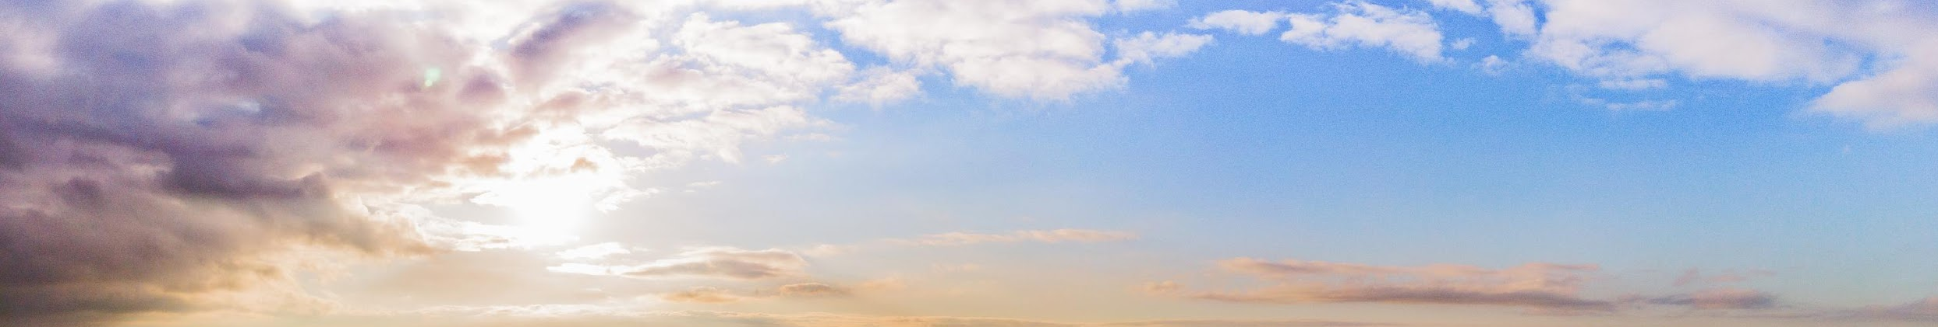

HARNESSING OUR POWER TO END POLITICAL VIOLENCE
First Exposure Training

Slide 2

WHY WE’RE HERE
Build understanding of the contours of political violence, especially in our own contexts
Awaken imagination about how we might assertively respond in the face of threats or acts of political violence
Explore concepts that can help us identify and undermine political violence
Practice tools and approaches you can use at home right now or in a moment of crisis
Connect with others who are also working to interrupt political violence
Celebrate the ways our communities have creatively resisted political violence

Slide 3

PART 1
Political Violence - Our Landscape
PART 2
Making Political Violence Backfire
AGENDA
PART 3
Applying Backfire Strategies
PART 4
Wrap-Up and Next Steps
HARNESSING OUR POWER TO END POLITICAL VIOLENCE
ENDPOLITICALVIOLENCE.ORG

Slide 4
GROUP AGREEMENTS FOR THIS SESSION
TODAY, WE’RE ASKING YOU TO:
Speak from your own experience and community; everybody has a role to play in preventing political violence
Move up, move back (self-awareness to manage participation)
Let discomfort lead to inquiry and explore tensions with grace
Difference between intent and impact
Nobody’s humanity is in question
Take care of each other, take care of yourself
Stories stay, lessons leave
HARNESSING OUR POWER TO END POLITICAL VIOLENCE
ENDPOLITICALVIOLENCE.ORG

Slide 5

WHAT IS POLITICAL VIOLENCE AND REPRESSION?
Political violence is threatening to hurt or hurting another person or group of people for political reasons.
Repression is the use of pressure or force against an individual or group in order to control or subdue the individual or group.
Sources: Harnessing Our Power to End Political Violence Guide and ICNC Glossary of Civil Resistance
HARNESSING OUR POWER TO END POLITICAL VIOLENCE
ENDPOLITICALVIOLENCE.ORG

Slide 6
WHY DO PEOPLE ENGAGE IN POLITICAL VIOLENCE AND REPRESSION?
These political reasons can include trying to:
Achieve a political goal
Assert political power over another group, and/or
Communicate a political message to an outside audience
HARNESSING OUR POWER TO END POLITICAL VIOLENCE
ENDPOLITICALVIOLENCE.ORG

Slide 7


THE IMPACTS OF POLITICAL VIOLENCE AND REPRESSION
Division
Distraction
Fear
Silence
HARNESSING OUR POWER TO END POLITICAL VIOLENCE
ENDPOLITICALVIOLENCE.ORG

Slide 8
WHO IS MOST TARGETED BY POLITICAL VIOLENCE?
Black communities
LGBTQ+ people
Immigrants and refugees
Women
Religious minorities
Activists in the news
Local elections workers
Local elected officials
State lawmakers
HARNESSING OUR POWER TO END POLITICAL VIOLENCE
ENDPOLITICALVIOLENCE.ORG

Slide 9
WHO DO WE CURRENTLY SEE BEING TARGETED BY POLITICAL REPRESSION?
HARNESSING OUR POWER TO END POLITICAL VIOLENCE
ENDPOLITICALVIOLENCE.ORG

Slide 10

AT THE HEART OF IT ALL…
Political violence is about sowing seeds of distrust in our communities.
It’s about dividing us into us versus them.
It’s about isolating us.
It’s about making us feel alone.
HARNESSING OUR POWER TO END POLITICAL VIOLENCE
ENDPOLITICALVIOLENCE.ORG

Slide 11
WHAT MAKES REPRESSION SUCCESSFUL?
HOW POLITICAL VIOLENCE WORKS
1
COVER UP
the injustice
2
DEVALUE
the target or victim
3
REINTERPRET
what happened in their favor
4
HIJACK
official channels to give a false sense of due process
5
INTIMIDATE AND BRIBE
people to support their tactics
HARNESSING OUR POWER TO END POLITICAL VIOLENCE
ENDPOLITICALVIOLENCE.ORG
From: Brian Martin, Backfire Manual: Tactics Against Injustice, Sparsnäs, Sweden: Irene Publishing, 2012.
Notes:
Cover it up: Hide the unjust actions, deny they ever happened, and prevent word from spreading about them.
Devalue the target: Try to lower the social standing of the target.
Reinterpret: Attempt to downplay the amount of damage caused by the injustice, portray the injustice as unavoidable or for a greater good, and/or deflect blame to others.
Use official channels: Set up inquiries and investigations that move slowly, limit public visibility or input, rely on technical rules, and provide only the appearance of justice.
Threats and rewards: Threaten people who may speak out against injustice, and reward people for remaining silent.

Slide 12

…BUT WE CAN GO ON OFFENSE!
The environment of political violence and repression threatens to drive us into our corners, sit on our hands, and wait to be rescued. It fosters helplessness and undermines our sense of agency.
HARNESSING OUR POWER TO END POLITICAL VIOLENCE
ENDPOLITICALVIOLENCE.ORG
Notes:
RECKONING/REFLECTION:
Take a minute - sit with the whatever’s real about living in a political context where this is happening -
How does this make you feel?
SPACE TO BREATHE

Slide 13

…BUT WE CAN GO ON OFFENSE!
We are here to reclaim our power and agency and imagine what we can do in the face of political violence!
HARNESSING OUR POWER TO END POLITICAL VIOLENCE
ENDPOLITICALVIOLENCE.ORG

Slide 14
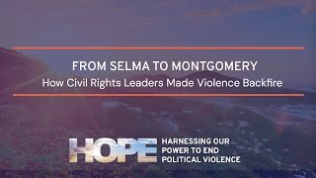
THE SELMA TO MONTGOMERY MARCHES
SELMA, AL | 1965

Slide 15
THE SELMA TO MONTGOMERY MARCHES
SELMA, AL | 1965
On March 7th, 1965, hundreds of people began to march peacefully in Selma, but the work leading up to that day began well before. For years, groups like the Southern Christian Leadership Conference and the Student Nonviolent Coordinating Committee had been holding lunch counter sit-ins and Freedom Rides to advocate for equal rights for Black Americans.
In anticipation of the violence they would encounter, they held nonviolent action workshops, during which they simulated the harassment they might face from supporters of segregation. They practiced responding to antagonization and violence with nonviolent discipline, song, and prayer. Organizers ensured photographers would be at the marches to capture evidence of any violence and injustice carried out against them.
HARNESSING OUR POWER TO END POLITICAL VIOLENCE
ENDPOLITICALVIOLENCE.ORG

Slide 16
THE SELMA TO MONTGOMERY MARCHES
SELMA, AL | 1965
On the day the march began, facing imminent violence from state troopers in Selma, organizers knew that the images of peaceful marchers being tear gassed and beaten by state troopers would reveal the grave injustices they had been suffering to the world.
Footage of the brutality they endured on “Bloody Sunday” was shown on national TV and in newspapers across the country. The images of Black people who had just left Sunday services being battered by white state troopers also pushed back on assumptions that the demonstrators were an angry and unruly mob.
And photos capturing the diversity of people who supported the movement by marching helped to re-frame the narrative that only Black Americans were participating in the Civil Rights movement. As organizers predicted, exposing these abuses led to widespread outrage that they were able to redirect into action.
HARNESSING OUR POWER TO END POLITICAL VIOLENCE
ENDPOLITICALVIOLENCE.ORG

Slide 17
THE SELMA TO MONTGOMERY MARCHES
SELMA, AL | 1965
Leaders in the movement sprang to action. Dr. Martin Luther King, Jr. called on religious leaders across the country to join them in their “peaceful, nonviolent march for freedom.” On March 9th, 2,000 people, marched to the Edmund Pettus Bridge where they knelt in prayer. And on March 21, they marched from Selma to Montgomery with the protection of federalized Alabama National Guardsmen and FBI agents.
The strategic efforts and actions of Civil Rights supporters at Selma are incredible examples of how a nonviolent movement can make violence perpetrated against it “backfire” and even leverage it to strengthen and advance its goals.
The power of these nonviolent strategies live on today, as activists and advocates around the world continue to use these tactics to make violence “backfire.”
HARNESSING OUR POWER TO END POLITICAL VIOLENCE
ENDPOLITICALVIOLENCE.ORG

Slide 18
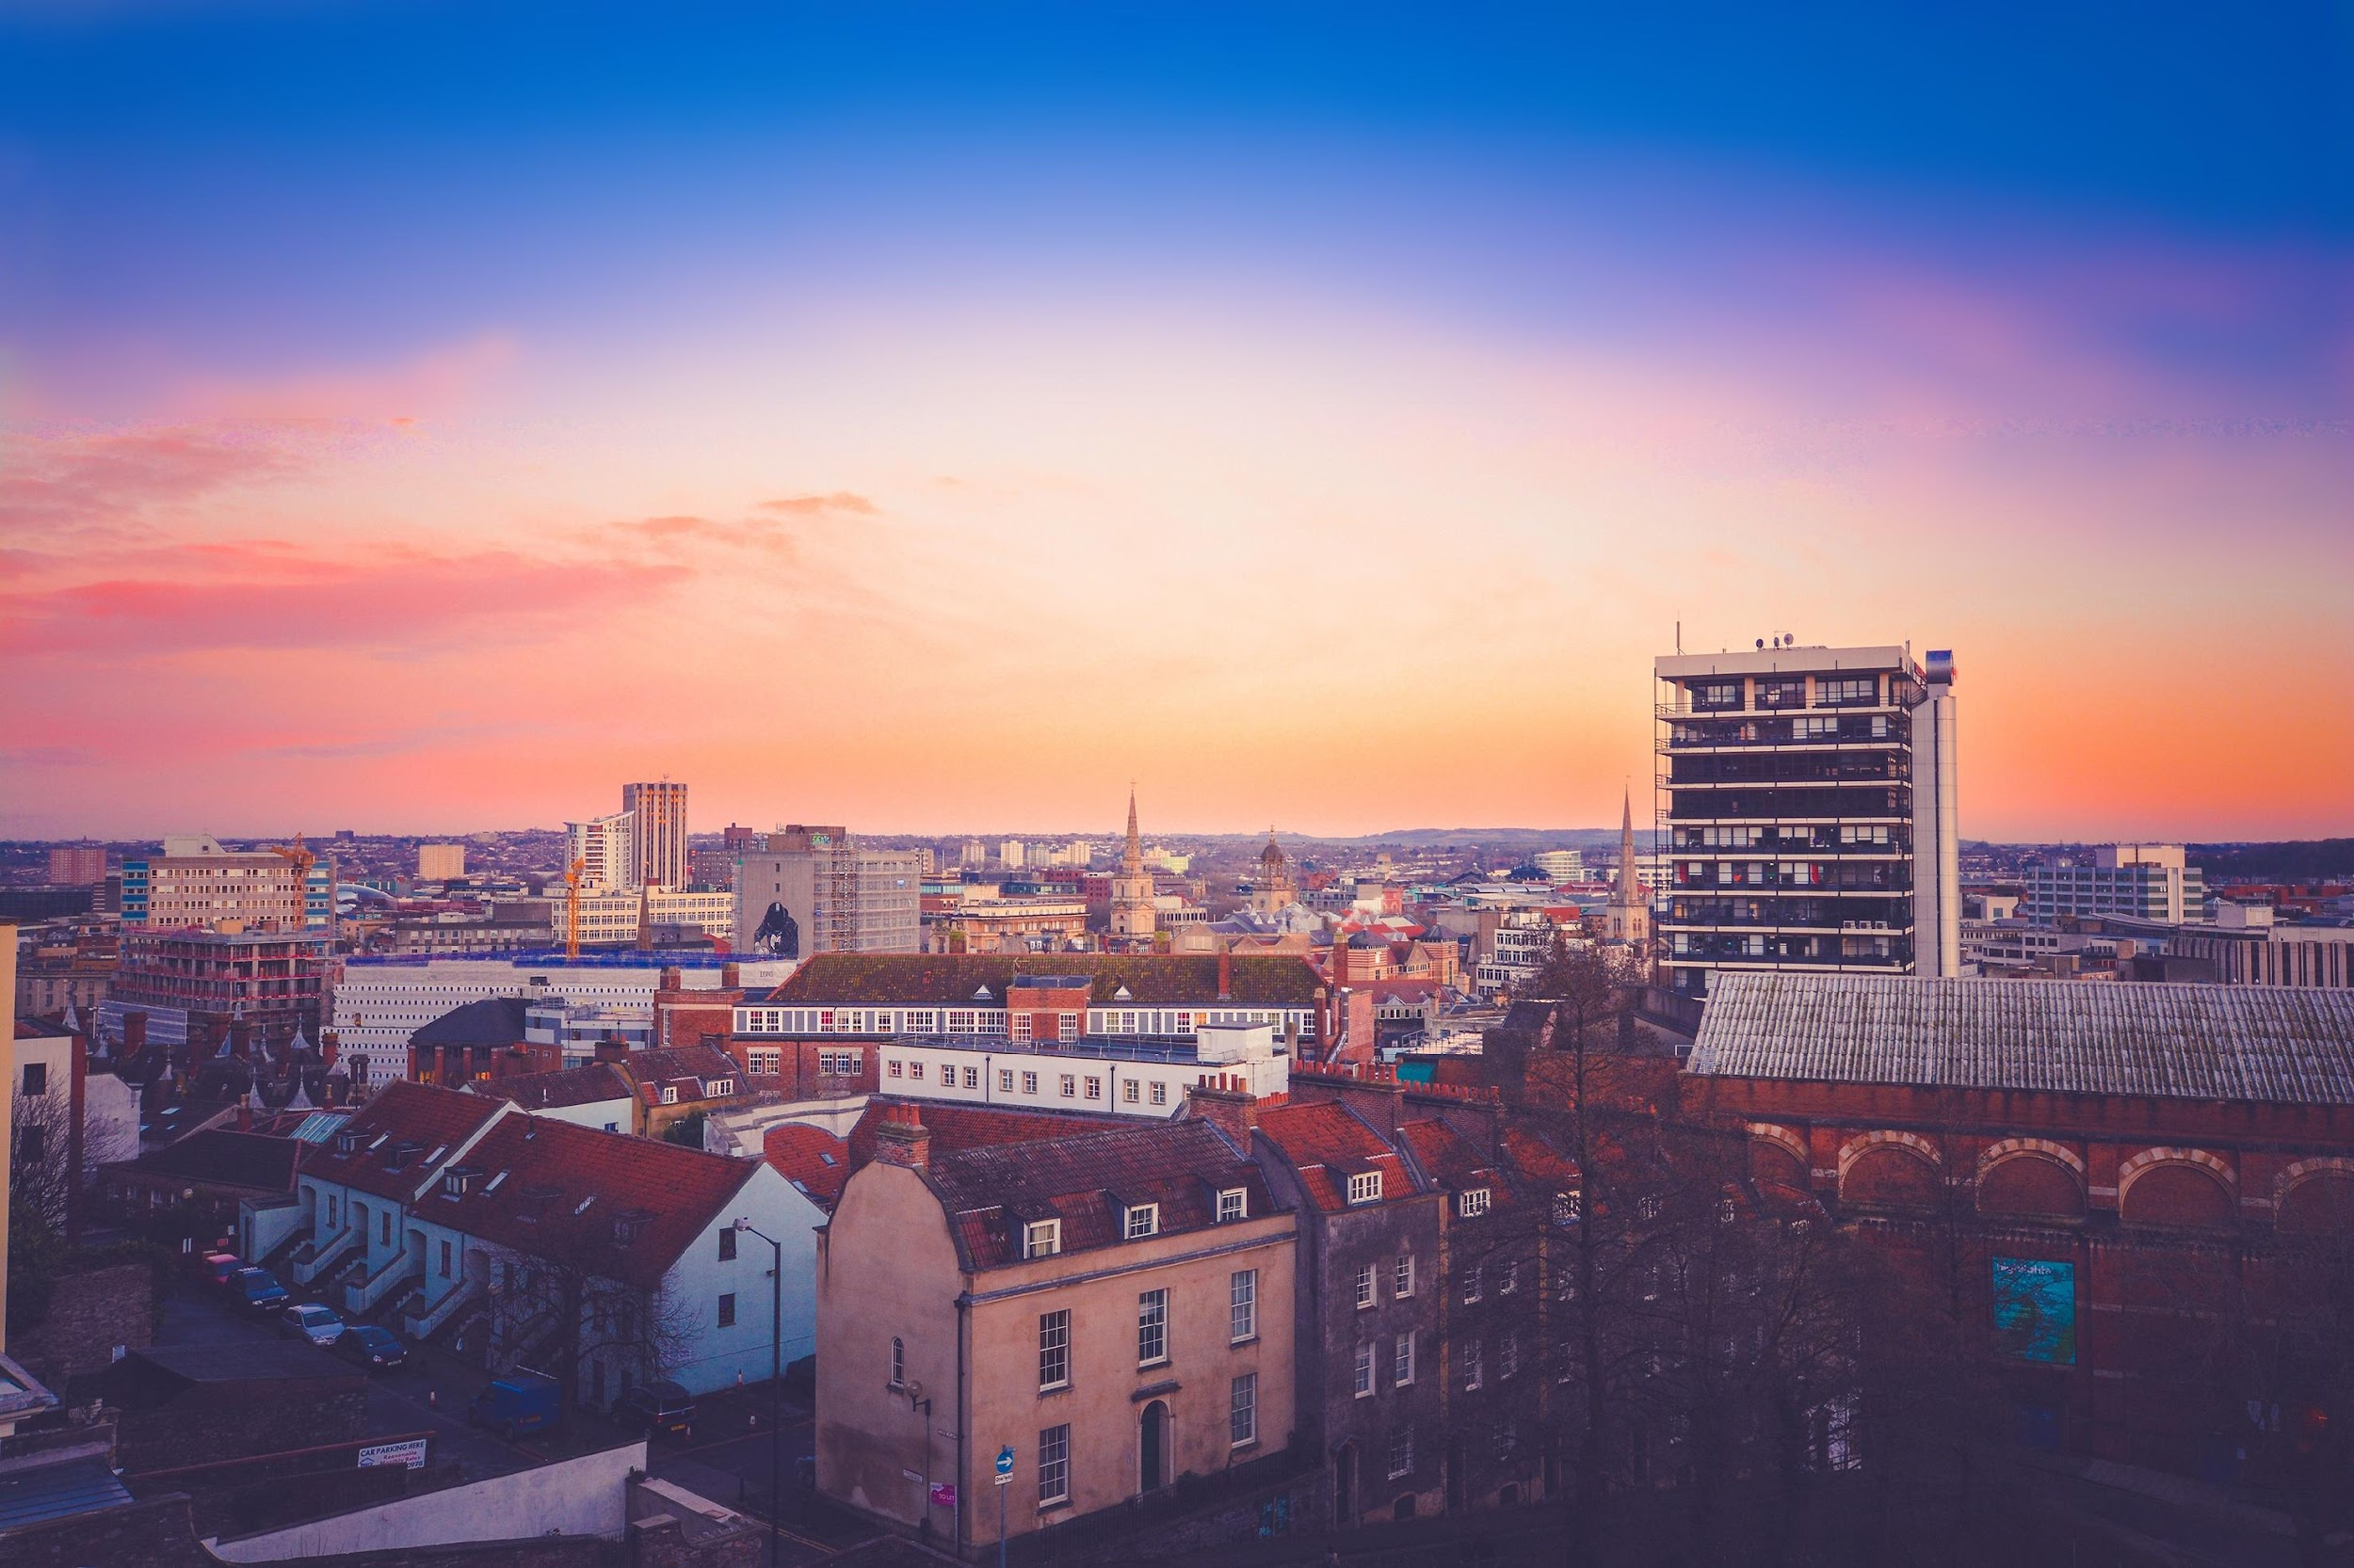
Let’s reflect …
What stood out to you from this story?
Take 5 minutes to discuss in breakout groups
HARNESSING OUR POWER TO END POLITICAL VIOLENCE
ENDPOLITICALVIOLENCE.ORG

Slide 19




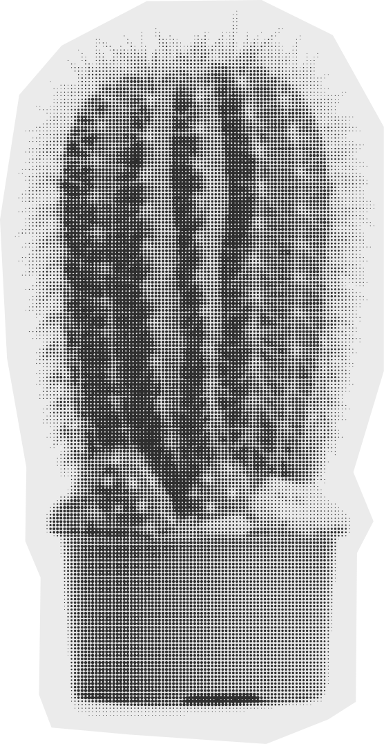
5 PRINCIPLES
MAKING POLITICAL VIOLENCE BACKFIRE
1
2
3
4
5
REVEAL
REDEEM
RE-FRAME
REDIRECT
RESIST
The goal of the “backfire” model is to make sure that when any kind of political violence takes place, perpetrators face high costs for their actions.
When their actions are counterproductive for them, their actions can be said to backfire.
HARNESSING OUR POWER TO END POLITICAL VIOLENCE
ENDPOLITICALVIOLENCE.ORG
Notes:
The costs imposed on perpetrators can take two forms:
Direct losses—including a loss of political support, a loss of social standing, economic losses, and in some cases being held legally accountable.
Increasing support, power, and mobilization in solidarity with targets of political violence by those who oppose it

Slide 20
5 PRINCIPLES
MAKING POLITICAL VIOLENCE AND REPRESSION BACKFIRE
1
REVEAL
Expose the injustice
2
REDEEM
Validate the target
3
RE-FRAME
Interpret the event as an injustice
4
REDIRECT
Mobilize support to not rely on official channels
5
RESIST
Resist intimidation and bribes
HARNESSING OUR POWER TO END POLITICAL VIOLENCE
ENDPOLITICALVIOLENCE.ORG

Slide 21
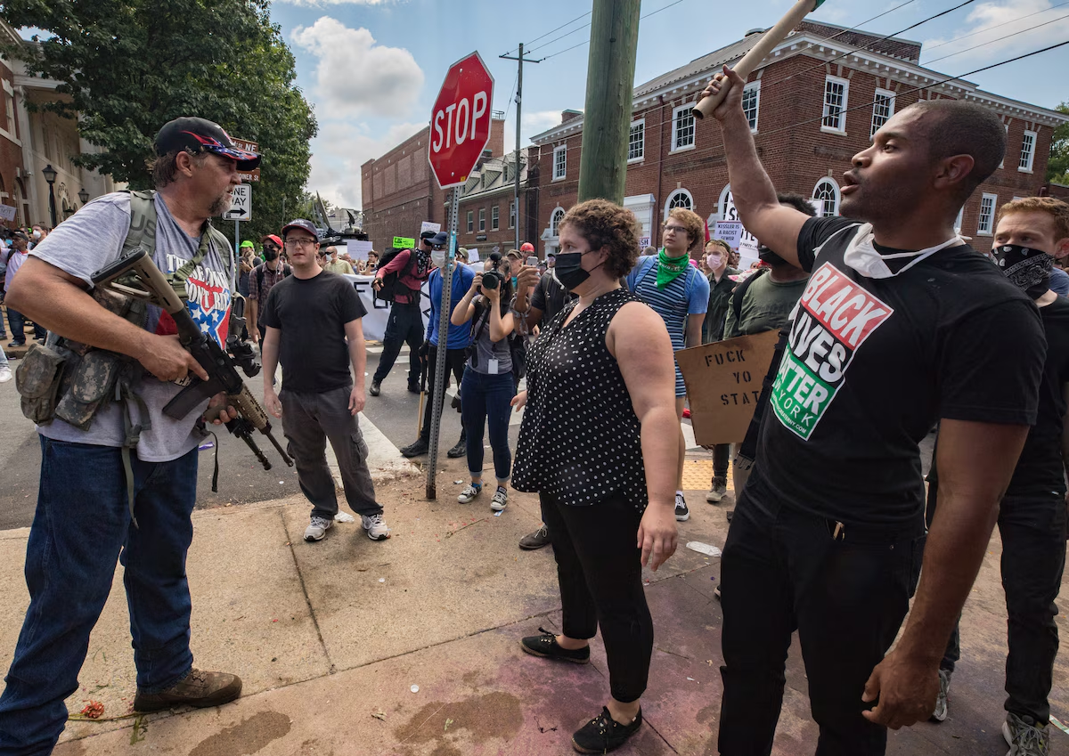
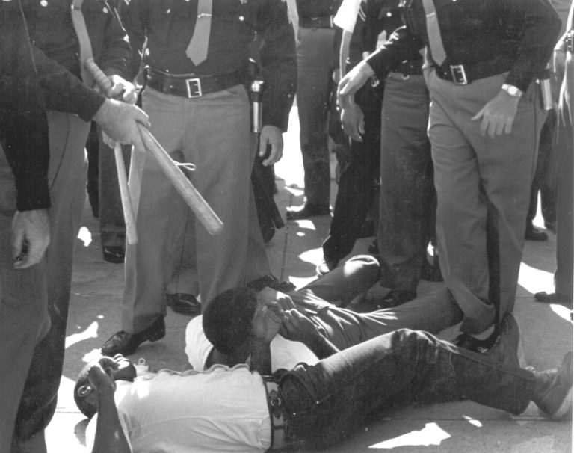
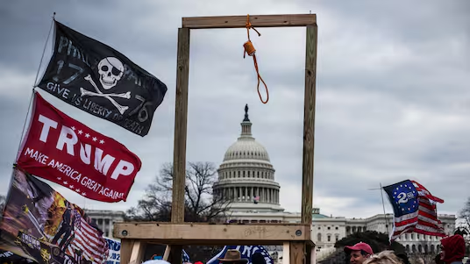
5 PRINCIPLES
1
MAKING POLITICAL VIOLENCE BACKFIRE
In order for injustice to backfire, it must be revealed.
REVEAL
ENDPOLITICALVIOLENCE.ORG
Notes:
CHOOSE PHOTOS AND EXAMPLES THAT WILL WORK FOR YOUR AUDIENCE (you can find some below)
Photos (from left to right): Photos that were widely circulated and evicted emotion: Gallows erected at the Capital during January 6th; Unite the Right armed protestor faces off with counter protestors in Charlottesville (2017); Police officers beat SNCC organizers for taking water to people waiting in line to vote
Revealing can happen through research and other forms of evidence gathering, or through detailed interviews with people who have suffered abuse
Sometimes revealing means creating conditions so that cover-up of a potential abuse is more difficult, such as when activists all carry cameras and plan ahead for sustained documentation of public actions
The evidence of injustice must be presented in a way that seems credible and that actually gets distributed.

Slide 22
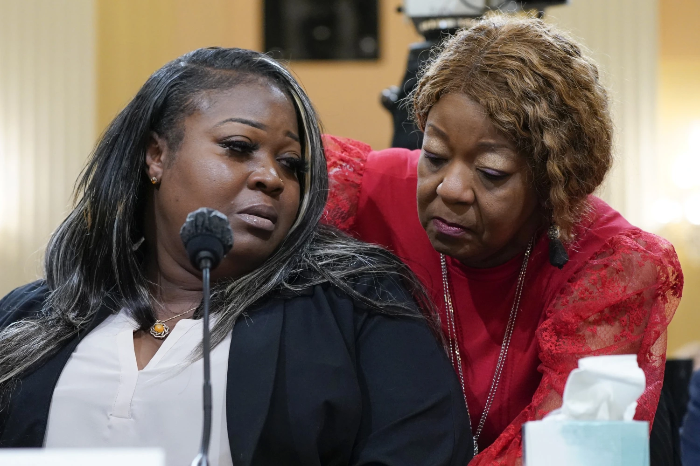
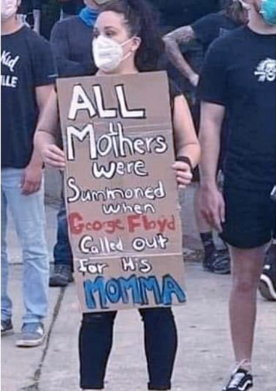
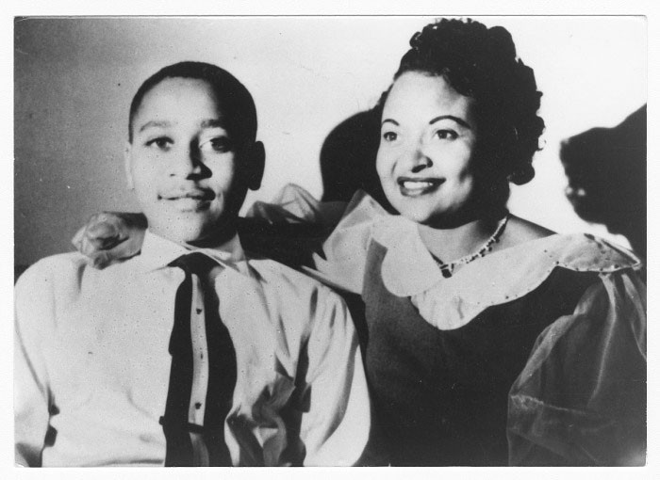
5 PRINCIPLES
2
MAKING POLITICAL VIOLENCE BACKFIRE
Counter devaluation by humanizing (redeeming) those who have been abused; this helps build support for targets so we can build power together
REDEEM
ENDPOLITICALVIOLENCE.ORG
Notes:
CHOOSE PHOTOS AND EXAMPLES THAT WILL WORK FOR YOUR AUDIENCE (you can find some below)
Photos (from left to right): Ruby Freeman and Shaye Moss share a moment during their congressional testimony on the impact election denialism had on their lives due to their jobs as election workers; Protestor holds sign in during George Floyd protests of 2020; Emmett Till poses for a picture with his mother, who worked tirelessly to share the story of her 14 year-old son, who was brutally murdered by an angry mob of white supremacists in MS
Provide context and details about the targets’ lives
Elevate their positive values and actions
Have others (especially those in roles that the audience trusts and respects) speak up on their behalf
Anticipate devaluation by conducting advance training and adopting a code of conduct for political activities that inoculates targeted individuals from being provoked by perpetrators

Slide 23
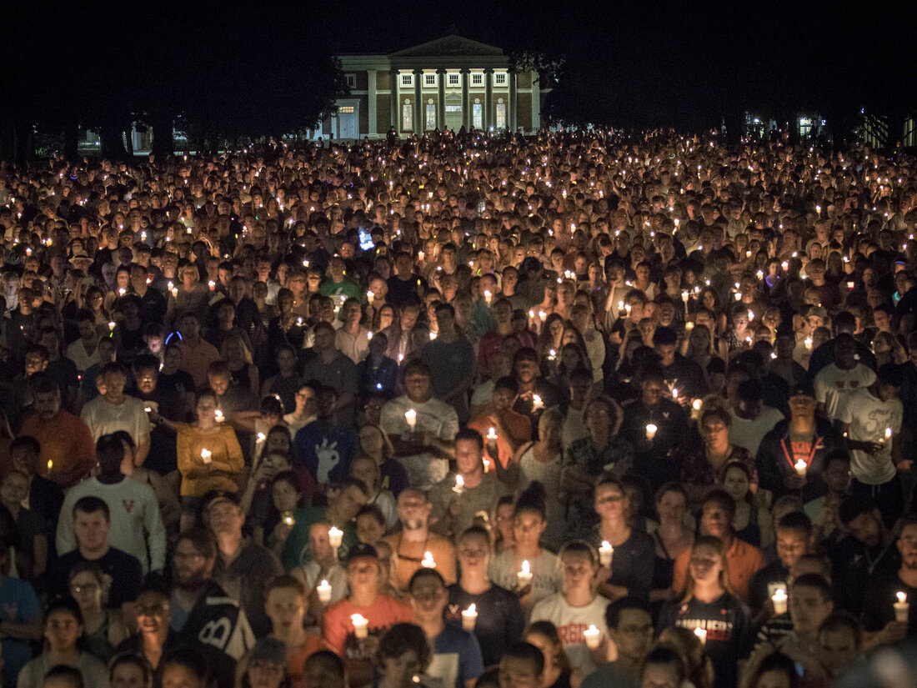
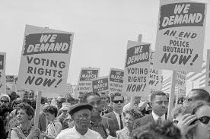
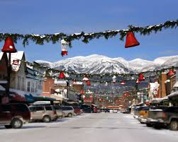
3
5 PRINCIPLES
MAKING POLITICAL VIOLENCE BACKFIRE
Counter perpetrators’ attempts to reinterpret incidents of injustice by reframing them as unjust.
RE-FRAME
ENDPOLITICALVIOLENCE.ORG
Notes:
CHOOSE PHOTOS AND EXAMPLES THAT WILL WORK FOR YOUR AUDIENCE (you can find some below)
Photos (from left to right): Whitefish, MT, where local businesses and churches joined organizers in putting up Love Lives Here signs in response to a neo-Nazi rally being planned by prominent White supremacist Richard Spencer and crew; Vigil for Heather Heyer and to stand for love and acceptance after Unite the Right rally in Charlottesville; March on Washington for voting rights after movement build up in the South
Document the impact of and damage from the abuse to help neutralize the perpetrators’ narratives
Communicate why the abuse was not justified and why it violates laws or widely held values
Communicate who should be held accountable for the abuse (for example, reframing abuse from an individual problem to a systemic problem)
Remember that while an injustice may seem obvious to activists, it should never be assumed that it is obvious to other audiences

Slide 24
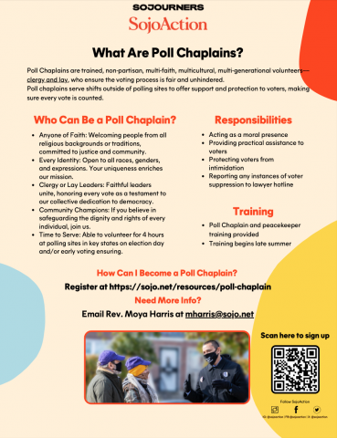
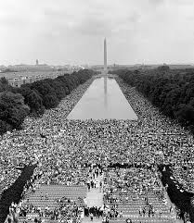

4
5 PRINCIPLES
MAKING POLITICAL VIOLENCE BACKFIRE
When perpetrators try to divert action into official channels, redirect public outrage toward mobilization.
REDIRECT
ENDPOLITICALVIOLENCE.ORG
Notes:
CHOOSE PHOTOS AND EXAMPLES THAT WILL WORK FOR YOUR AUDIENCE (you can find some below)
Photos (from left to right): Protect Democracy graphics highlighting how perpetrators are trying to hijack official channels so people understand what’s happening in their plans to hold the channels accountable; Poll worker mobilization across pillars; March on Washington when civil rights legislation was stalled or didn’t fully meet needs
Remember that public or independent investigations tend to work slowly, focus on technical procedures, rely on experts, and give the appearance that justice will be done. This can result in decreased public mobilization, making inquiries less aggressive in pursuing the truth.
Backfire options include:
supporting the process
criticizing the process
making demands of the process
launching a parallel process
using the institutional process as a campaigning tactic

Slide 25
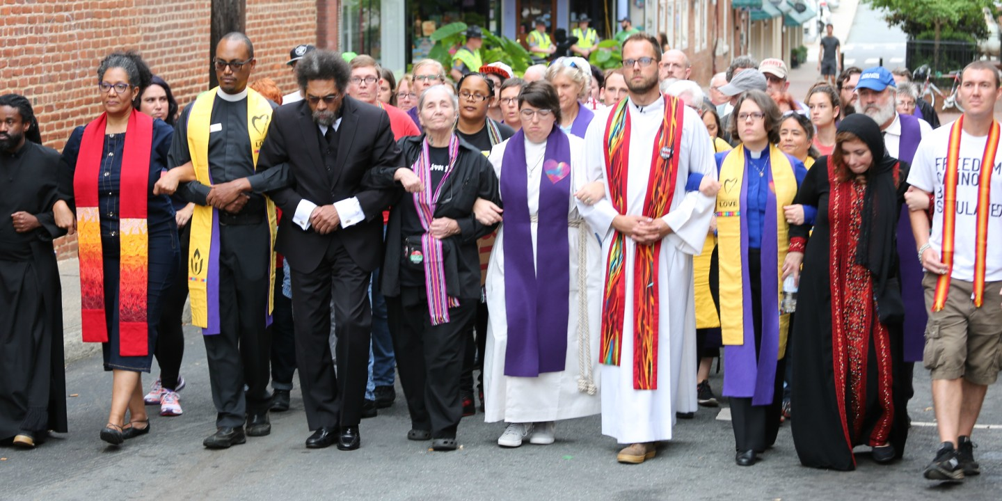
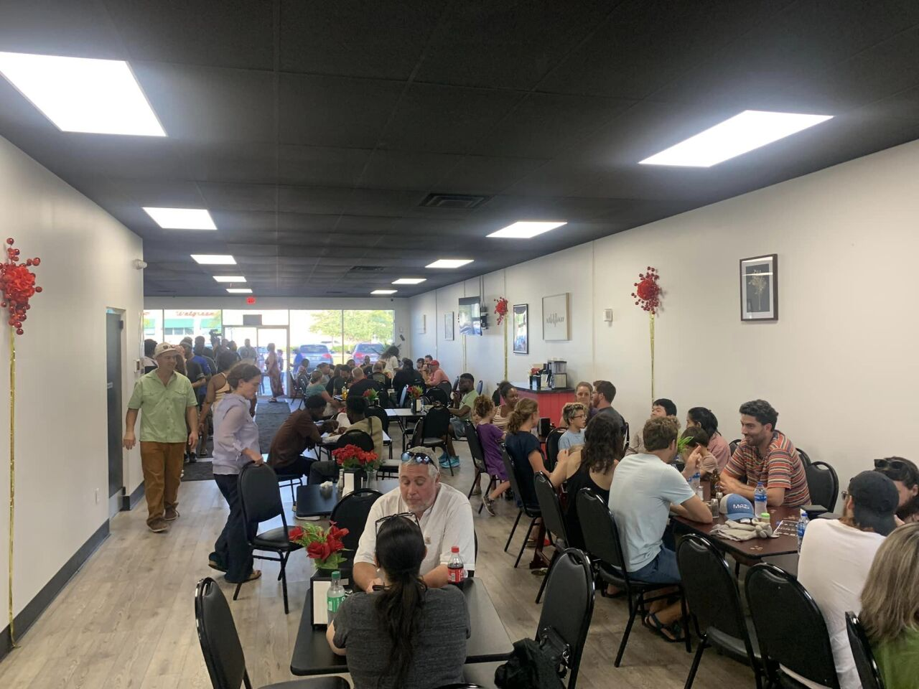
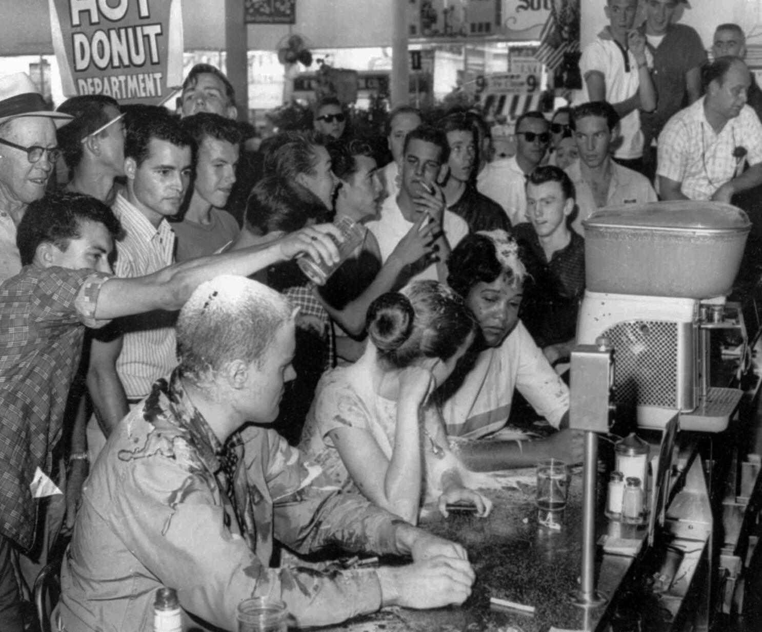
5
5 PRINCIPLES
MAKING POLITICAL VIOLENCE BACKFIRE
Resist threats and attempts to reward silence about injustice, turning these into catalysts for more backfire.
RESIST
ENDPOLITICALVIOLENCE.ORG
Notes:
CHOOSE PHOTOS AND EXAMPLES THAT WILL WORK FOR YOUR AUDIENCE (you can find some below)
Photos (from left to right): Reverse boycott at Haitian business in Springfield, OH; Faith leaders marching to protect counter protestors at Unite the Right rally; Greensboro cross-race lunch counter sit-ins that inspired more young people to drive South to join the movement
Attempts to inhibit public concern by threatening, bribing, intimidating, or otherwise co-opting those who speak out or organize against injustice may extend beyond targeted activists—sometimes perpetrators may further try to silence activists’ family, friends, and colleagues
Anticipating intimidation and rewards, activists can warn their friends, families, and colleagues of such efforts, prepare to document these efforts, and develop strategies to make them backfire if or when they happen.
Being public about the fact that a group is prepared for threats may actually have a deterrent effect on perpetrators, making them aware ahead of time that such tactics will be used against them in “the court of public opinion,” and possibly also even a court of law.

Slide 26
RESPONDING TO TACTICS OF REPRESSION
MAKING POLITICAL VIOLENCE BACKFIRE
1
REVEAL
1
COVER UP
Expose the injustice
the injustice
the target or victim
2
DEVALUE
Validate the target
2
REDEEM
RE-FRAME
3
REINTERPRET
3
Interpret the event as an injustice
what happened in their favor
HIJACK
4
REDIRECT
official channels to give a false sense of due process
4
Mobilize support to not rely on official channels
Resist intimidation and bribes
people to support their tactics
INTIMIDATE AND BRIBE
5
RESIST
5
HARNESSING OUR POWER TO END POLITICAL VIOLENCE
ENDPOLITICALVIOLENCE.ORG
From: Brian Martin, Backfire Manual: Tactics Against Injustice, Sparsnäs, Sweden: Irene Publishing, 2012.
Notes:
Note: This slide is animated so that the text does not overlap but rather shows how each backfire principle addresses a tactice perpetrators of PV use to try to get away with what they did.

Slide 27
BREAK
HARNESSING OUR POWER TO END POLITICAL VIOLENCE
ENDPOLITICALVIOLENCE.ORG

Slide 28

EXTREMIST PV CASE STUDY
When political violence originates from extremist groups and militias
HARNESSING OUR POWER TO END POLITICAL VIOLENCE
ENDPOLITICALVIOLENCE.ORG

Slide 29
LOVE LIVES HERE
WHITEFISH, MONTANA | 2016-2017
Whitefish, Montana, a town of about 8000 people, is known for its natural beauty and occasional celebrity sightings. In 2017, it received national news coverage when neo-Nazis were planning an armed march on Martin Luther King Day to promote white supremacy.
A community group called “Love Lives Here” took a stand.
As the date of the march approached, businesses that relied on tourism and had a strong interest in countering the perception of community intolerance, posted “Love Lives Here” stickers in their windows, along with images of menorahs.
Then, the trolling began.
HARNESSING OUR POWER TO END POLITICAL VIOLENCE
ENDPOLITICALVIOLENCE.ORG

Slide 30
LOVE LIVES HERE
WHITEFISH, MONTANA | 2016-2017
The neo-Nazis posted negative reviews online about these businesses to try to intimidate the owners and other community members.
But the Love Lives Here campaign also had a digital strategy. The community responded by flooding the internet with positive reviews and patronizing the businesses – an example of what civil resistance scholars call a reverse boycott.
A week before the scheduled neo-Nazi march, hundreds of families showed up to a ‘Love Not Hate’ rally that emphasized tolerance and a welcoming spirit. They created a ‘matzo ball soup brigade’ and wore blue wigs to “troll the trolls.”
With all of this collective action, government officials were able to resist the pressure to allow the parade and instead denied the march their permit.
HARNESSING OUR POWER TO END POLITICAL VIOLENCE
ENDPOLITICALVIOLENCE.ORG

Slide 31

TURNING POLITICAL VIOLENCE ON ITS HEAD
1
2
3
4
5
REVEAL
REDEEM
RE-FRAME
REDIRECT
RESIST
HARNESSING OUR POWER TO END POLITICAL VIOLENCE
ENDPOLITICALVIOLENCE.ORG

Slide 32

APPLYING BACKFIRE STRATEGIES
HARNESSING OUR POWER TO END POLITICAL VIOLENCE
ENDPOLITICALVIOLENCE.ORG

Slide 33
Let’s brainstorm backfire!
Small groups Instructions
In your small groups, follow these steps:
Pick a scenario from the list on the next slide
Make a plan to respond using one or more of the backfire principles
HARNESSING OUR POWER TO END POLITICAL VIOLENCE
ENDPOLITICALVIOLENCE.ORG

Slide 34
POSSIBLE SCENARIOS
Neo-nazi groups march on public sidewalks outside the entrance to a local congregation around worship time
Non-profit organizations that serve LGBTQ+ populations receive bomb threats
Aggressive crowd control tactics used against a group of peaceful protestors
HARNESSING OUR POWER TO END POLITICAL VIOLENCE
ENDPOLITICALVIOLENCE.ORG

Slide 35
5 PRINCIPLES
MAKING POLITICAL VIOLENCE BACKFIRE
1
REVEAL
Expose the injustice
2
REDEEM
Validate the target
3
RE-FRAME
Interpret the event as an injustice
4
REDIRECT
Mobilize support and avoid official channels
5
RESIST
Resist intimidation and bribes
HARNESSING OUR POWER TO END POLITICAL VIOLENCE
ENDPOLITICALVIOLENCE.ORG

Slide 36
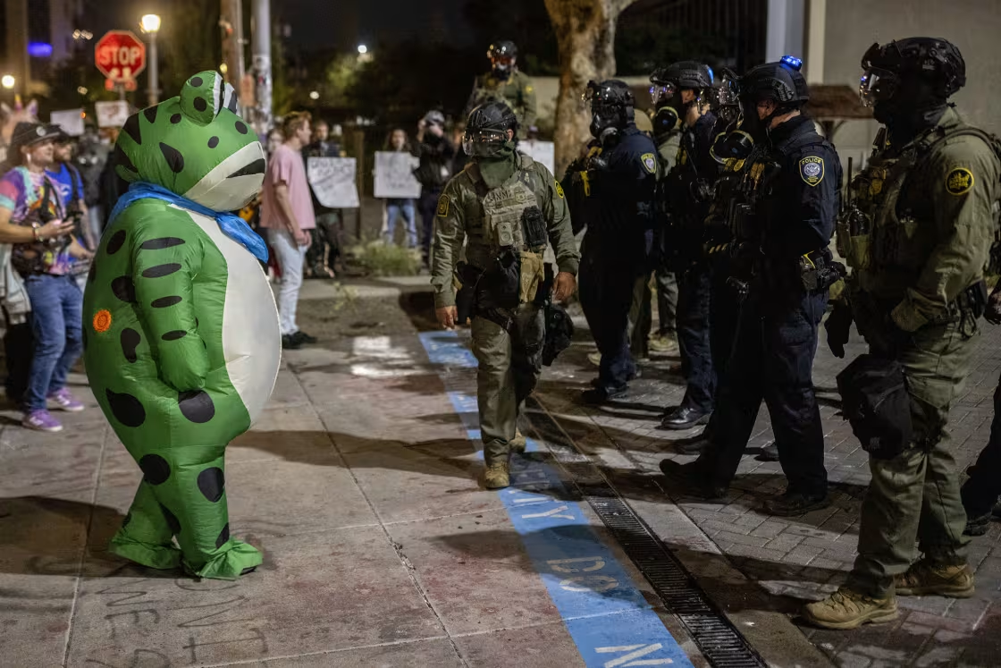
Questions?
https://www.endpoliticalviolence.org/

